Slide 1


Using Entity Resolution to Enhance Criminal Network Disruption by Targeting Appropriate Offenders
Dr Rick Adderley
A E Solutions (BI) Ltd
www.a-esolutions.com

Slide 2

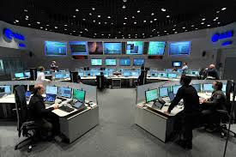


Typical Crime
Command & Control
Crime Reported
System Updated
House Burgled
Crime Recording System
System Updated
Officer Attends the Crime Scene
Forensic Recording System
CSI Attends the Crime Scene
System Updated

Slide 3
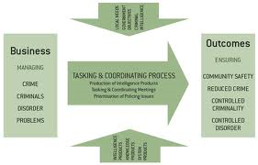
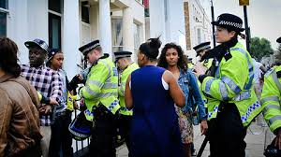
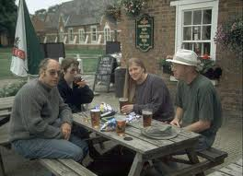
Typical Crime
Stop & Search System
Stop & Search
System Updated
NIM T&C
Intelligence System
Gathering Intelligence
System Updated

Slide 4
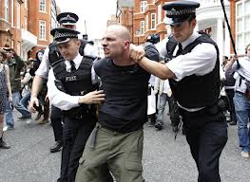

Typical Crime
Custody System
System Updated
Offender Arrested
Crime Nominals System
Crime Solved
System Updated

Slide 5
Linking Data
Custody System
Intelligence System
Command & Control
Crime Nominals System
Crime Recording System
Person Reference Number
Crime Number
Forensic Recording System
Stop & Search System

Slide 6
Typical Crime
URN | Surname | Forename | DOB | Address
TY123456/09 | Smith | Billy | 12/04/1976 | 123 High Street
GH734569/11 | Smythe | Billy | 12/04/1976 | 123 High Street
TY123456/09 | Smith | Billy | 04/12/1976 | 123 High Street
TY123456/09 | Smith | Billy | 12/04/1976 | 132 High Street
ZZ765833/10 | Smith | Billy | 12/04/1976 | 123 High Street
All Names and Data are Synthetic

Slide 7


Entity Resolution Gold Standard
Crime Recording System
1002 Crimes for Analysis
Crime Nominals System
Ref. Nos
Names
Addresses
Dates of Birth
1 ½ Days !
Offences
Crime Info

Slide 8
Gold Standard
Set ID | Ref Num | Surname | Forename | DOB
71 | 765304C | CHASS | MILKOV | 25/03/1984 00:00
71 | 765304C | CHASS | MILKOV | 25/03/1984 00:00
71 | 765304C | CHASS | MILKOV | 25/03/1984 00:00
71 | 765304C | CHASS | MILKOV | 25/03/1984 00:00
71 | 765304C | CHASS | MILKOV | 25/03/1984 00:00
71 | 765304C | CHASS | MILKOV | 25/03/1984 00:00
71 | 765304C | CHASS | MILKOV | 25/03/1984 00:00
71 | 765304C | CHASS | MILKOF | 25/03/1984 00:00
71 | 765304C | CHASS | MILKOVR | 25/03/1984 00:00
71 | 765304C | CHASS | MILKOV | 25/03/1984 00:00
71 | 12125304M | CHASS | MILKOV | 25/03/1984 00:00
71 | 56334K | CHASS | MILKOV | 25/03/1984 00:00
71 | 765304C | CHASS | MILKOV | 25/03/1984 00:00
71 | 765304C | CHASS | MILKOV | 25/03/1984 00:00
72 | 894921Q | CHASS | MILKOV | 18/03/1985 00:00
72 | 894921Q | CHASS | MILKOV | 18/03/1985 00:00
73 | 1773119D | CHASS | MILKOV | 15/09/1985 00:00
74 | 756422Y | CHASS | MENKOV | 31/01/1976 00:00
75 | 1583173Q | CHASS | MENKOV | 27/08/1977 00:00
71 | 2018476W | CHAS | MENKOV | 25/03/1984 00:00
71 | 2018476W | CHASS | MENKOV | 25/03/1984 00:00
76 | 1057182L | CHASS | MENKOV | 16/04/1985 00:00
76 | 1057182L | CHASS | MENKOV | 16/04/1985 00:00
76 | 1057182L | CHASS | MENKOV | 16/04/1985 00:00
76 | 2254896J | CHASS | MENKOFF | 16/04/1985 00:00

Slide 9
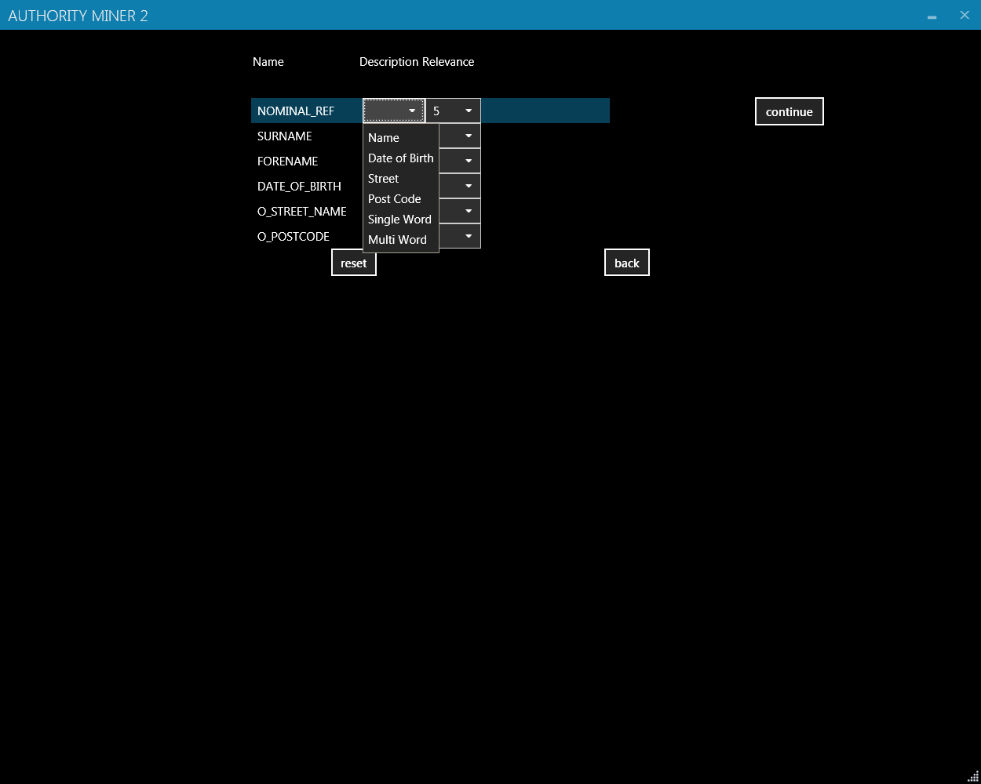
Entity Resolution
Crime Nominals System
Data Extract
List of Fields
URN | Surname | Forename | DOB | Address
TY123456/09 | Smith | Billy | 12/04/1976 | 123 High Street
GH734569/11 | Smythe | Billy | 12/04/1976 | 123 High Street
TY123456/09 | Smith | Billy | 04/12/1976 | 123 High Street
TY123456/09 | Smith | Billy | 12/04/1976 | 132 High Street
ZZ765833/10 | Smith | Billy | 12/04/1976 | 123 High Street

Slide 10
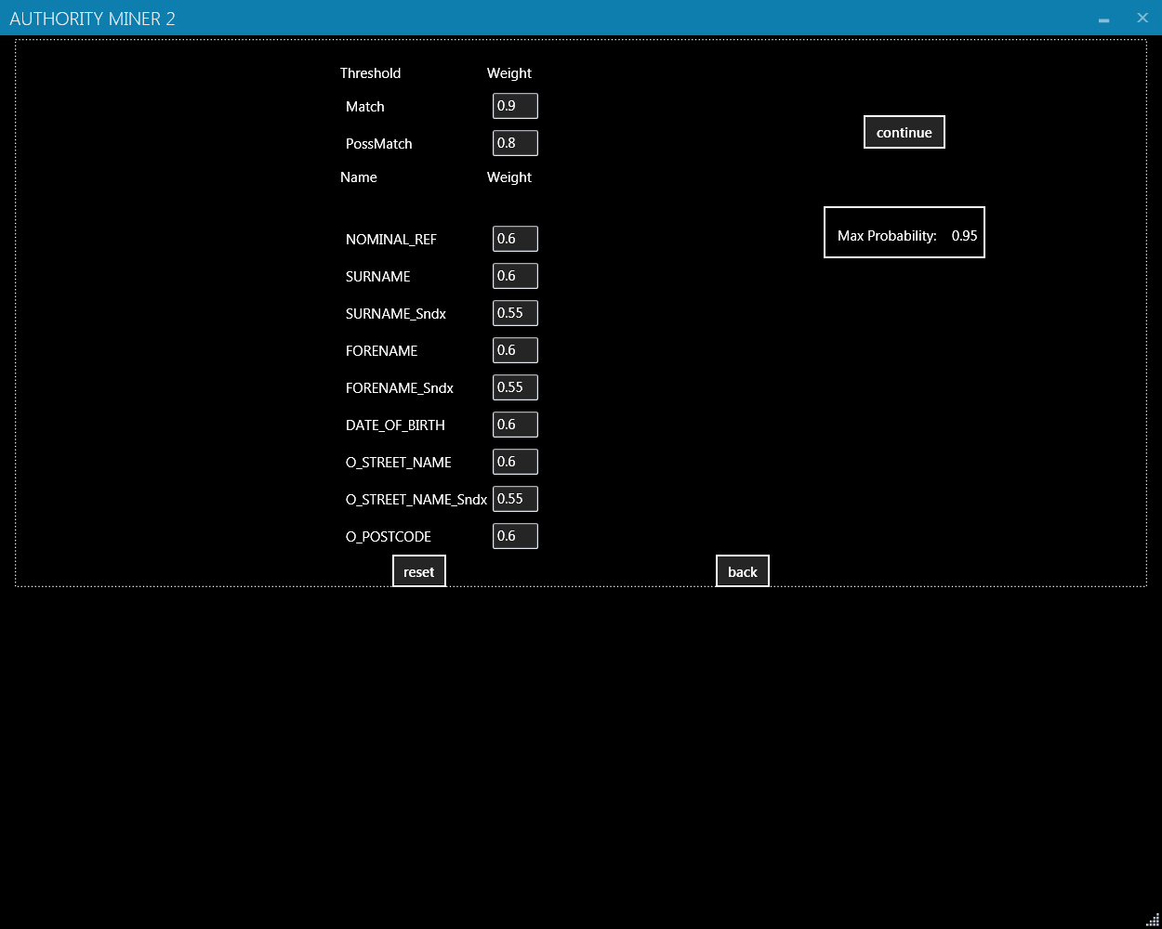
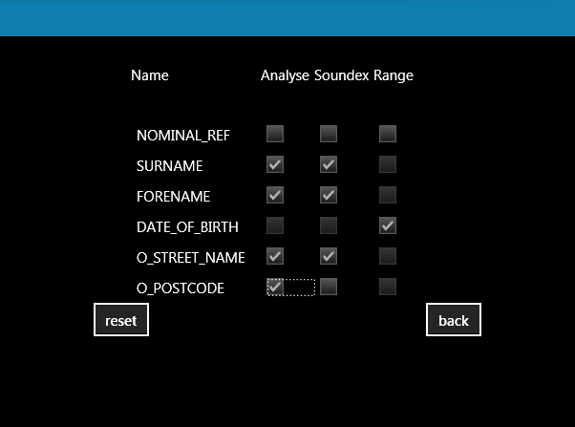
Entity Resolution
3 ½ Minutes

Slide 11
Entity Resolution
30 Test Runs
Fields
Relevance
Probability
Analysis
88.14% Accurate
Compared with Gold Standard

Slide 12
Entity Resolution
Nominal_Ref | Surname | Forename | DOB | EntityID | EntityName | AESResultID | AESType
15923596N | TOLZMANN | NONA | 02-Dec-83 | 1849170 | Offender | 6 | M
15923596N | TOLZMANN | NONA | 02-Dec-83 | 2160092 | Offender | 6 | M
15923596N | TOLZMANN | NONA | 02-Dec-83 | 1823467 | Offender | 6 | M
9899232XX | TOLZMANN | NONA | 03-Dec-83 | 66786/05 | Intel | 6 | P
52A | TOLZMANN | NONA | 02-Dec-83 | DE1/8377/05 | S&S | 6 | P
15923596N | TOLZMANN | NONA | 02-Dec-83 | 68189/05 | Intel | 6 | M
15923596N | TOLZMANN | NONA | 02-Dec-83 | 63845/05 | Intel | 6 | M
Different Police Systems

Slide 13
Criminal Networks
1st Degree

Slide 14
Criminal Networks
2nd Degree

Slide 15
Criminal Networks
2nd Degree – Different Target

Slide 16
Criminal Networks
2nd Degree – Different Target

Slide 17
Criminal Networks
2nd Degree – Different Target

Slide 18
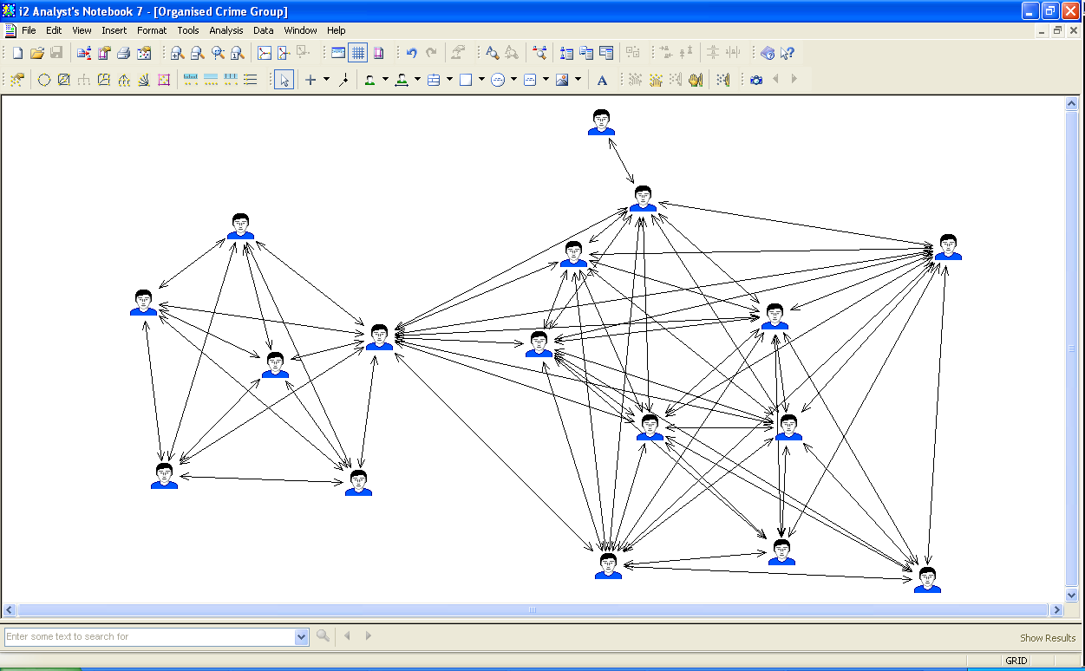
Actual Results
Organised Crime Group

Slide 19
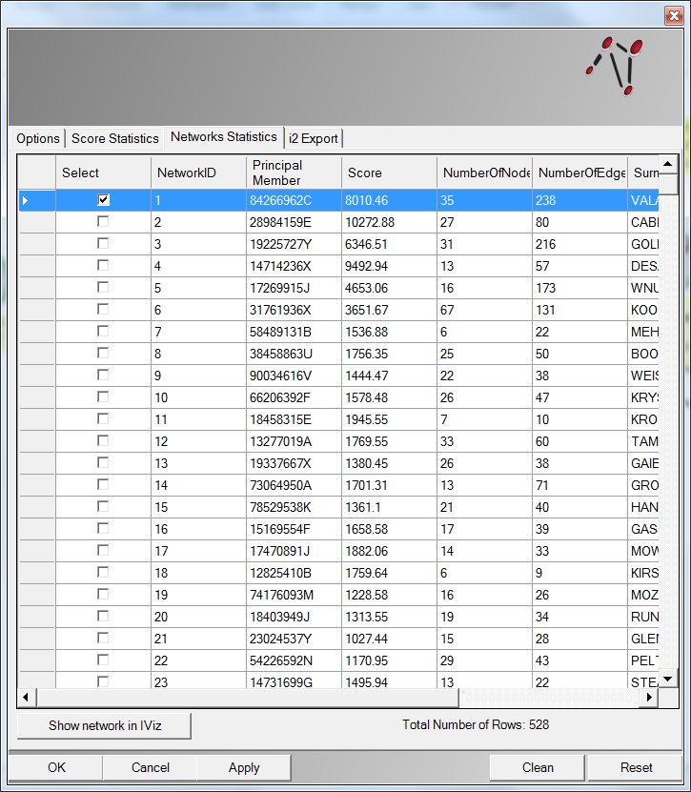
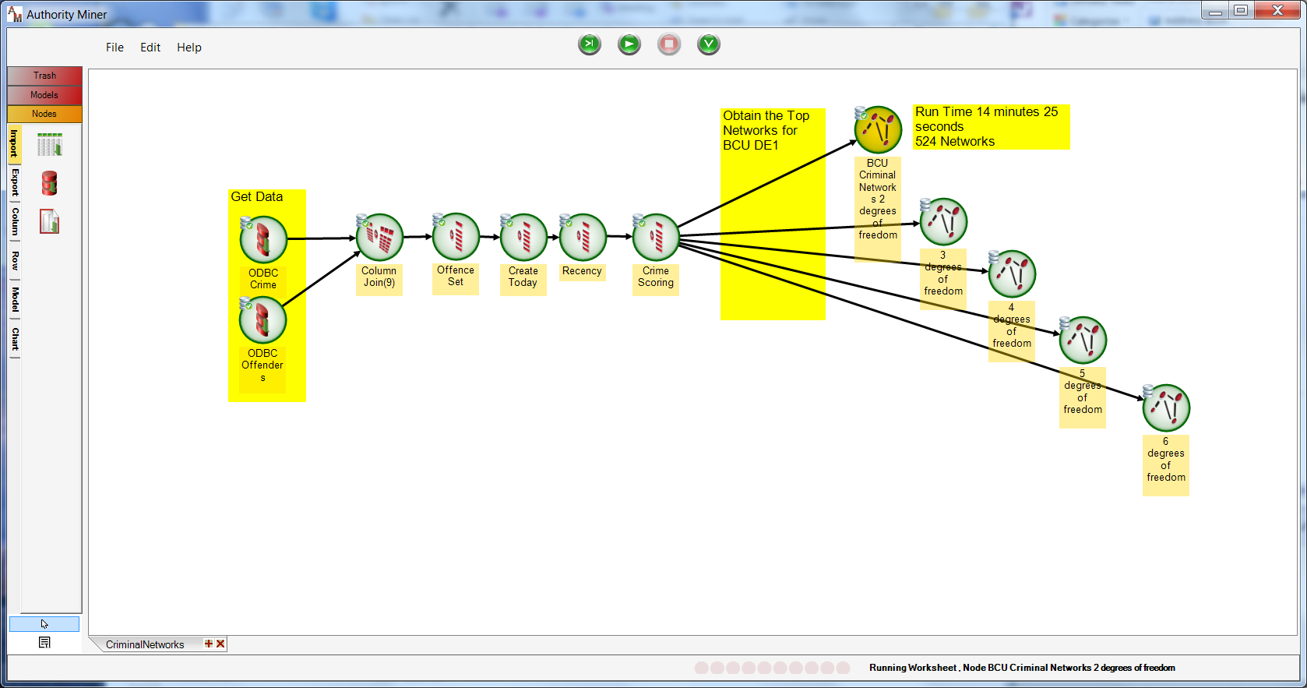
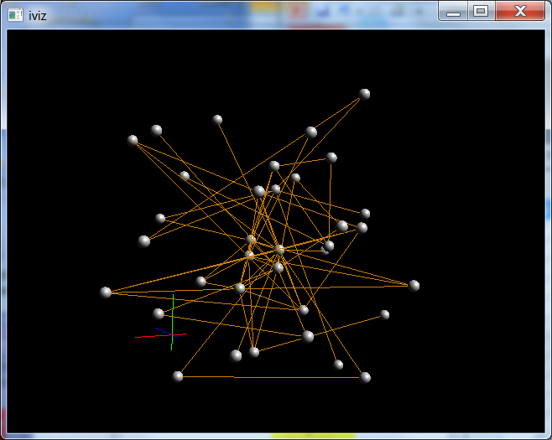
Identifying Relevant Criminal Networks

Slide 20
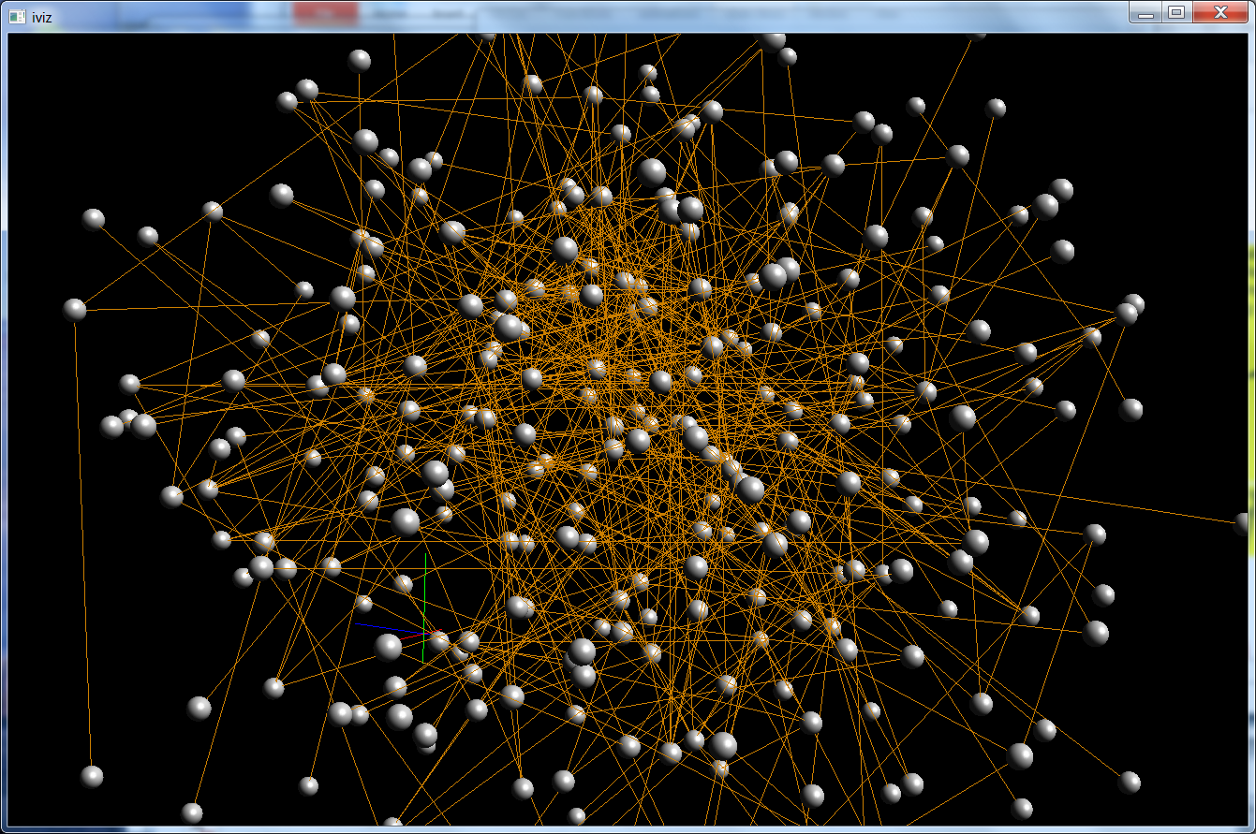
Why 2 Degrees of Freedom?

Slide 21
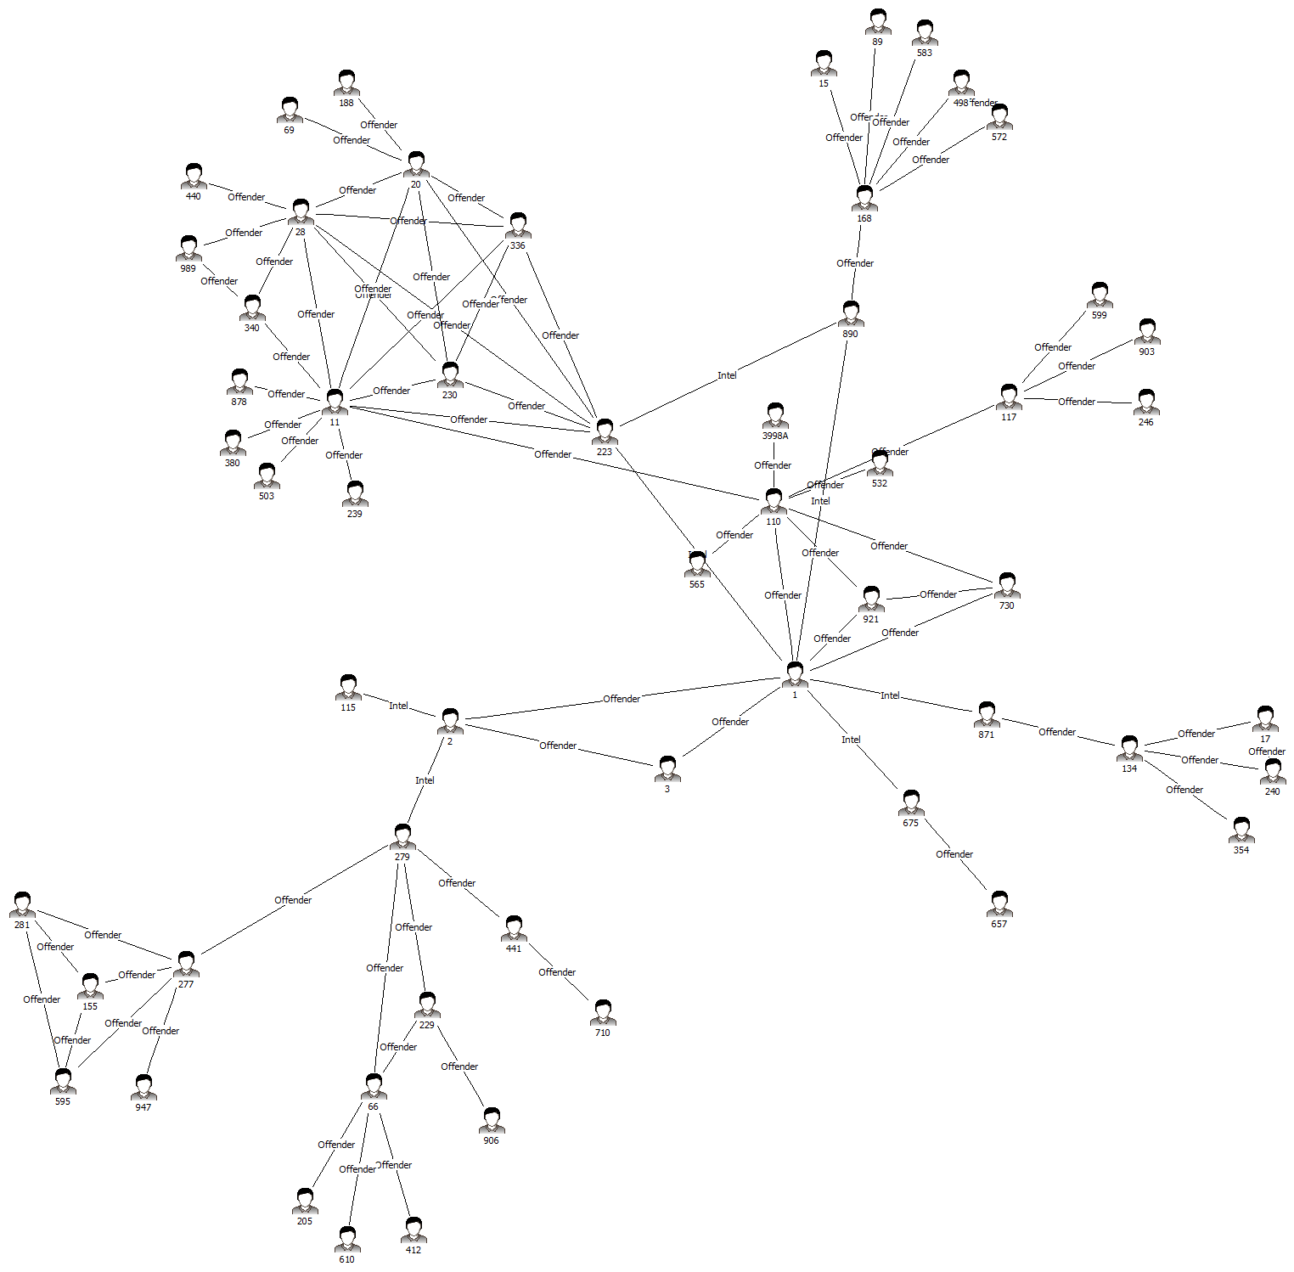
Sample Network
Who Do We Target ?

Slide 22
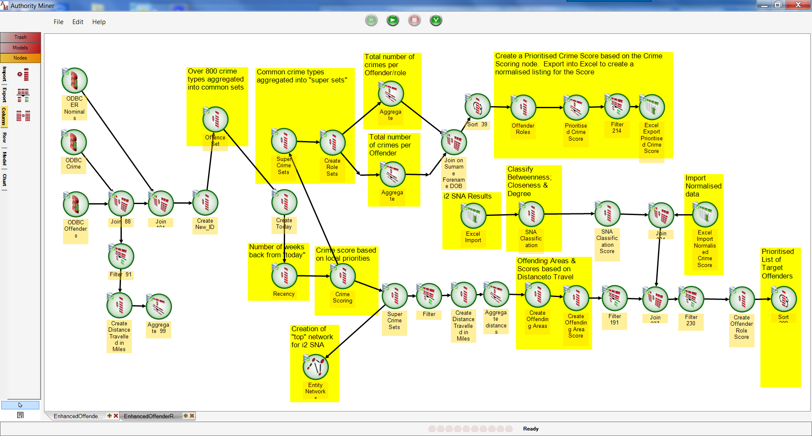
Identifying Offenders to Target

Slide 23
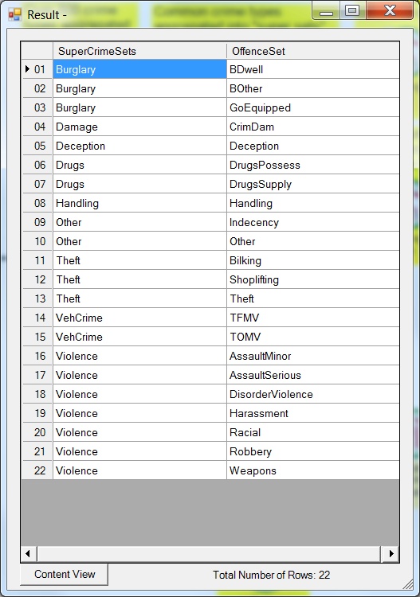
Creating Crime Sets
Crime Super Set

Slide 24
Normalised Crime Score
Frequency of crime
> 50% Single Type is main Role
Surname | Forename | DOB | Offender Roles | Normalised Crime Score
ROMINGER | PALMIRA | 28/02/1945 00:00 | Burglary | 11.95
SCHEBEL | CATHERN | 16/10/1981 00:00 | Burglary | 12.00
SIBBETT | MELITA | 05/12/1979 00:00 | Burglary | 9.95
CAPASSO | BELLA | 17/12/1980 00:00 | Burglary | 4.07
MOLDREM | VERNITA | 12/08/1982 00:00 | Burglary | 4.41
PINICK | TOYA | 07/05/1985 00:00 | Violence | 4.07
TOLZMANN | NONA | 02/12/1983 00:00 | Violence | 4.16
MEHLING | ARIE | 23/12/1986 00:00 | Violence | 4.16
VALASQUEZ | CAITLIN | 10/06/1987 00:00 | Violence | 4.07
ARMEL | KEMBERLY | 29/12/1985 00:00 | Violence | 4.07

Slide 25
SNA Scoring
Betweenness – labelled as a gatekeeper / information control
Top 10% An information controller Score = 3
  11%-20% Some involvement Score = 2
  Others No involvement Score = 1
Closeness – best access to other parts of the network
Top 10% Best access Score = 3
  11%-20% Average access Score = 2
  Others Limited access Score = 1
Degree – most active based on the number of links
Top 10% Active Score = 3
  11%-20% Fairly active Score = 2
  Others Not active Score = 1

Slide 26
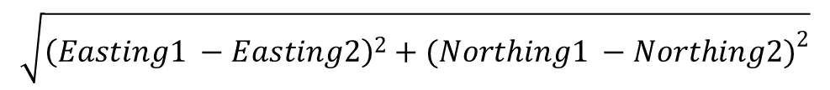
Distance to Crime
Euclidian Distance
$$\sqrt{{\left(Easting1 −Easting2\right)}^{2}+{(Northing1 −Northing2)}^{2}}$$
Merging that distance in miles with the main offences that the offenders commit and assessing the average and standard deviations for every crime committed by an offender the following labelling was applied:
The average distance <= Standard deviation *2 Compact Offending Area Score = 3
The average distance >= Standard deviation *3 Wide Offending Area Score = 2
All others Average Offending Area Score = 1

Slide 27
Offenders to Target
Surname | Forename | Role | Normalised Score | Informant Score | Access Score | Criminal Activity Score | Travel Score | Final Score | Final Normalised Score
SCHEBEL | CATHERN | Burglary | 12.00 | 3 | 3 | 2 | 3 | 23.00 | 1.14
ROMINGER | PALMIRA | Burglary | 11.95 | 2 | 2 | 2 | 3 | 20.95 | 1.00
SIBBETT | MELITA | Burglary | 9.95 | 1 | 2 | 1 | 3 | 16.95 | 0.71
FEDELE | MARTIN | Burglary | 5.40 | 2 | 2 | 3 | 3 | 15.40 | 0.60
DOMENECH | INOCENCIA | Burglary | 5.08 | 2 | 2 | 2 | 3 | 14.08 | 0.51
GILLINGHAM | BRINDA | Violence | 4.90 | 2 | 2 | 2 | 3 | 13.90 | 0.49
MEMOS | DENICE | VehCrime | 4.77 | 2 | 2 | 2 | 2 | 13.77 | 0.48
ROSENBALM | BRITNI | VehCrime | 4.57 | 2 | 2 | 2 | 3 | 13.57 | 0.47
UREN | MURIEL | Violence | 4.45 | 2 | 2 | 2 | 3 | 13.45 | 0.46
KRIEG | INGRID | VehCrime | 4.41 | 2 | 2 | 2 | 1 | 13.41 | 0.46
WOODLE | ARNITA | Burglary | 4.35 | 2 | 2 | 2 | 3 | 13.35 | 0.45
CROSSEN | BERNADINE | Burglary | 4.34 | 2 | 2 | 2 | 1 | 13.34 | 0.45
HOCKENBURY | PANDORA | VehCrime | 4.34 | 2 | 2 | 2 | 3 | 13.34 | 0.45
DELEEUW | STEPHANIE | Burglary | 4.28 | 2 | 2 | 2 | 2 | 13.28 | 0.45

Slide 28
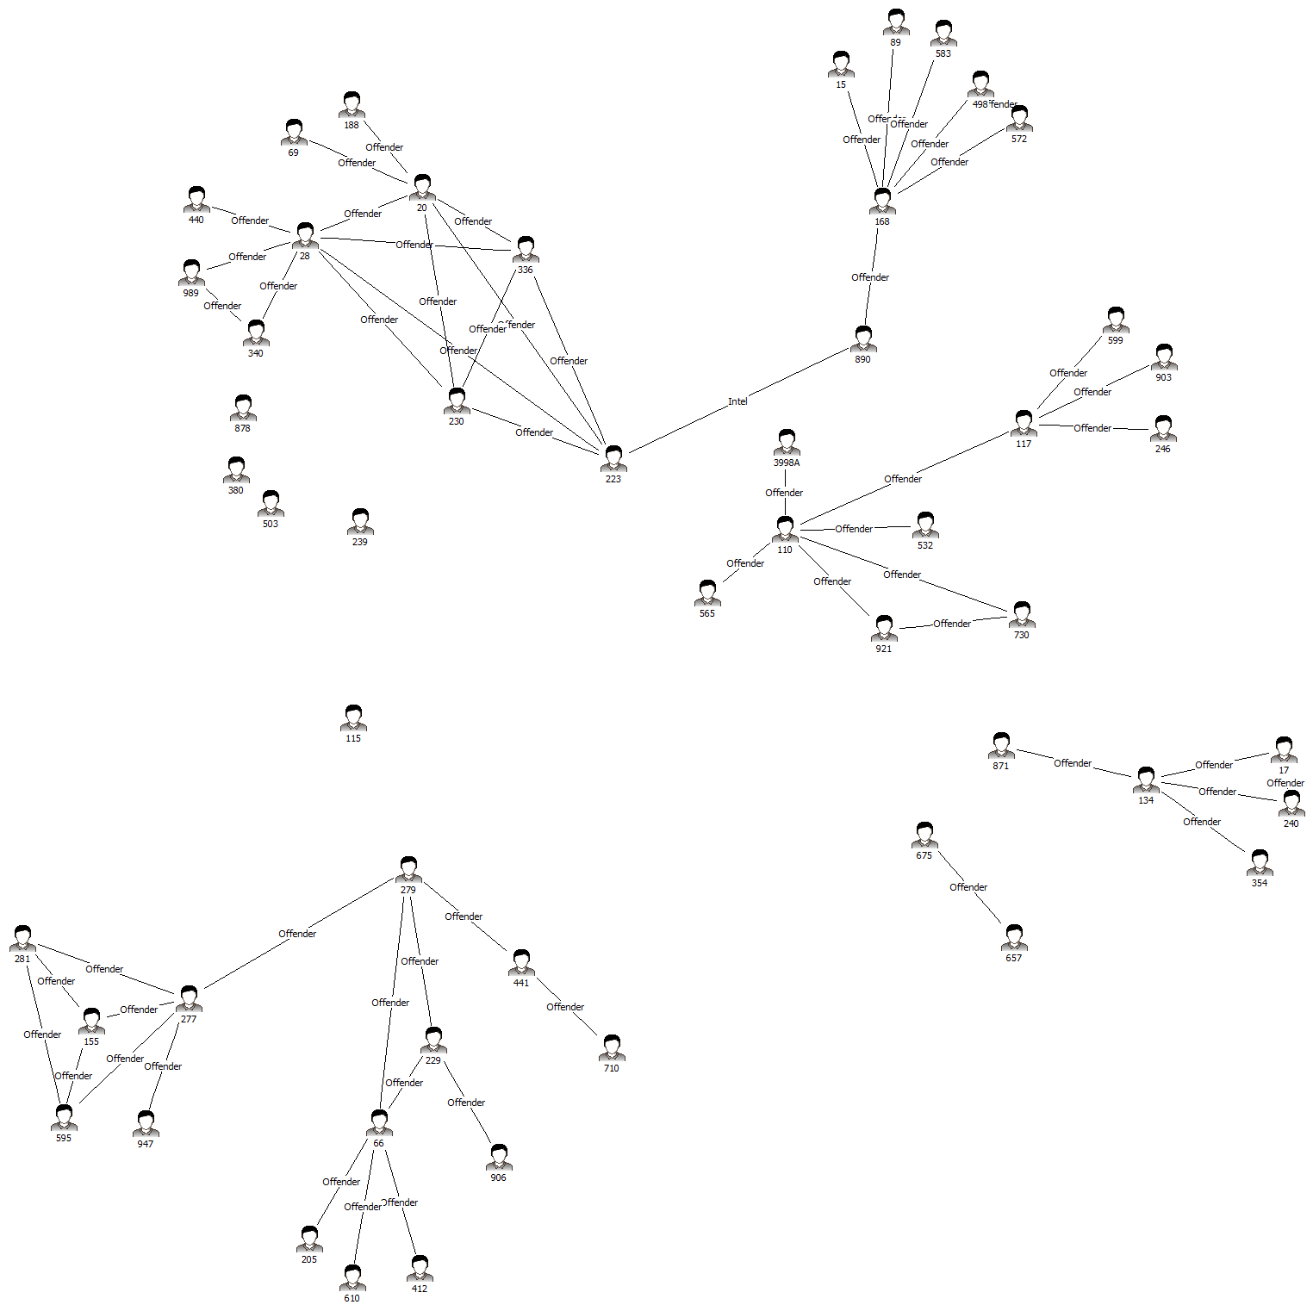
Disrupted Network
Original Network

Slide 29
Questions ?
Dr Rick Adderley
rickadderley@a-esolutions.com
www.a-esolutions.com

